Slide 1
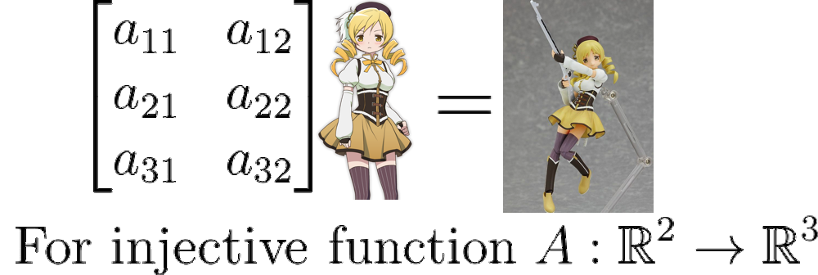
Programming linear algebra things in python
-How to comprehend in it
-Why should this matter

Slide 2
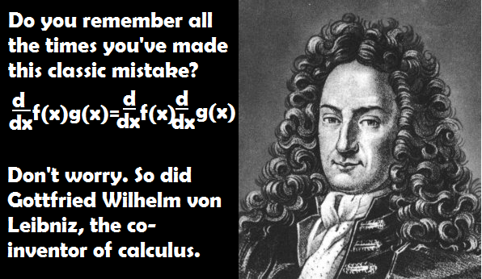
Linear algebra is integral to most calculations
This field is where one would study a line, a plane, a subspace, a point, and somehow figure out the correlation of one image to another
An intense change in intensity between pixels would be considered an edge and this observation is key in image recognition software today
No calculus required!
But if you did learn Calculus(basic differentiation), you could solve such problems as the Schrodinger equation

Slide 3

What could I possibly use Python for?
Easy to learn language, extendable, no semicolons!
Visualize data with one of Python’s various modules( Scipy, Numpy, Matplotlib etc)
Numpy’s built-in ndarray allows for powerful, fast matrix processing for multi-dimensional homogenous data types
http://numpy.scipy.org/
(Nd-array) N-dimensional array of square-like data
UFUNC(Universal functions)- Allow for broadcasting, processing matrices
Among other things like typecasting

Slide 4
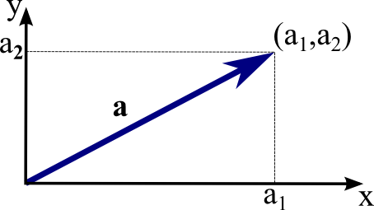
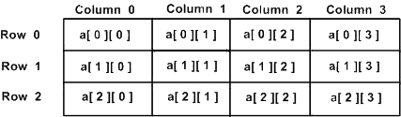

What is vector?
Essential to linear algebra, the vector describes point and direction of data, this is usually finitary in linear algebra, usually described as $\hat{i}\left(like x\right),\hat{j}(like y)$
$\left[\begin{matrix}\hat{i} \\ \hat{j}\end{matrix}\right] are known as the basis vectors in 2d space, like the origin$
The Tail the vector’s point of origin, the head when it ends
Magnitude of |a| is ${(a}_{1}∗$ $a_{2}$)/2.
$\left[\begin{matrix}\hat{i} \\ \hat{j}\end{matrix}\right]\begin{matrix}2 \\ 1\end{matrix} would be the vector sum, 2,1 is scalar$
Head
Tail
Magnitude
What about matrix?
A set of numerical data, expressions, or symbols arranged in rows(m) and columns(n)
Can be described as an array of data
Can be built off of vectors

Slide 5
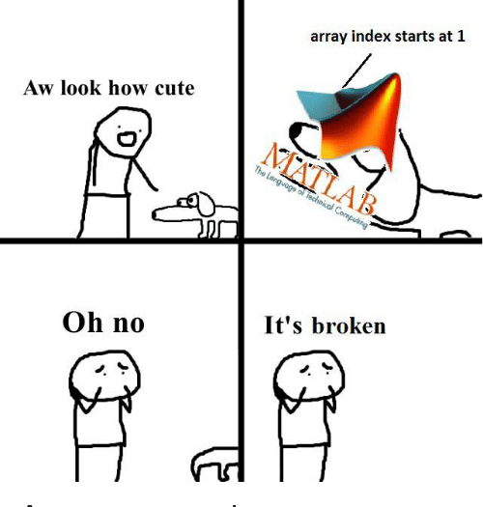
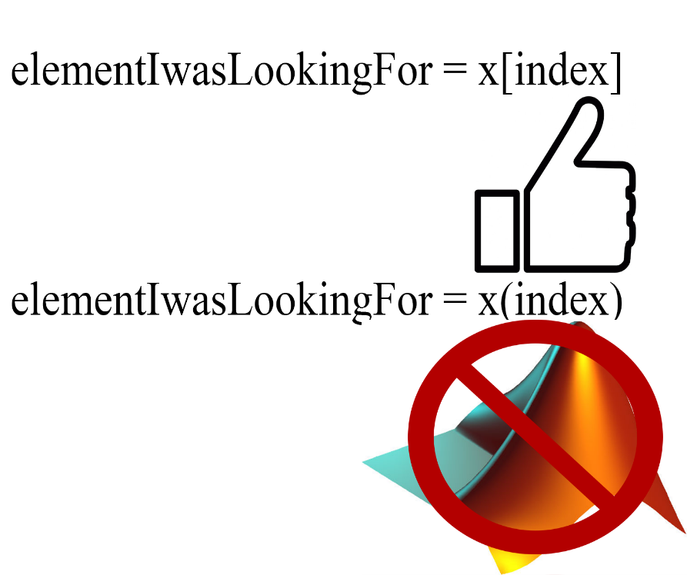
Numpy
>>> a = array([0,1,2,3])
>>> a
array([0, 1, 2, 3])
Describing a 1x4 array
Since python knows previously described array, it prints it out
>>> type(a)
<type 'array'>
The array information is stored in a cache and these commands extract commands from the header of the data
>>> a.dtype
dtype(‘int32’)
Coercion in code
Ex: Assigning a float to into # an int32 array will truncate decimal part.
>>> a[0] = 10.6
>>> a
[10, 1, 2, 3]

Slide 6
Matplotlib- Fast, on-the-go data visualization
import matplotlib.pyplot as plt
X= ([1,2,3,4])
plt.plot(x)
plt.ylabel(' numbers')
plt.show()

Slide 7
Why learn this?
Economics: Price (ex. function f) depends on supply and demand (the two components of the two-dimensional vector x). If you do economics, linear algebra is a good idea.
Politics: If more roads are built, capacity goes up (good for business) but quality of life goes down. People move away, which results in more traffic, which results in less excess capacity, which is bad for business. Many variables and complex connections could lead to multivariate calculus. This instead could be described in linear algebra and people in politics or poly sci ought to know this to think about problems like these.
Physics: If you don't watch a moving car from the outside but sit in the car, you are changing your frame of reference. This corresponds to a change of basis in linear algebra, which naturally pops out the centrifugal force (and the Coriolis force) from your force expression.

Slide 8
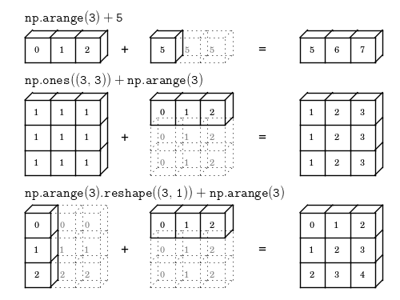
What is broadcast in python?
Broadcasting describes how we treat arrays with different shapes during arithmetic operations.
The smaller array is “broadcast” across the larger array so that they have compatible shapes, subject to broadcasting
Rules:
NumPy compares their shapes element-wise.
It starts with the trailing dimensions, and works its way forward.
Two dimensions are compatible when they are equal, or one of them is 1.

Slide 9
Why should I use python for my mathematical hijinks?
Python provides a platform for easy extensibility
Large swath of extensible libraries and plenty of online support.
This effectively and efficiently makes Python something like Matlab but better
Allows for fast algorithms on machine data types on rectangular data ex. Array([0, 2, 4, 6, 8 ,10])
Syntax is kept simple through not having to reference everything and therefore follows the KISS principle
Keeping the syntax simple (not like java) allows for faster compiling as you have less code to compile, runtime lag tends to be less.

Slide 10
Data abstraction
In OOP, you can have several classes which can implement a single interface
A client of that interface doesn’t require the specifics used in the implementation of interface
In linear algebra, we have a field representing the data abstraction (it’s best to think of fields like a class which implements pure functions such as +,-,*,%
As long as the implantation of the fields in a class follows the rules of linear algebra, we can utilize linear algebra in whatever application we choose to follow. This generality via fields provides versatility in programming whatever.
I.e the field of real numbers, cardinality, can aid in computing computer graphics through its ties to geometry
Binary and other base numbers can be used in cryptography
Signal processing and other processes dynamic in nature such as load balancing a network or polymorphic engines which change/time require complex numbers
Python features many of these data structures making the barrier to entry into linear algebra implementation lower

Slide 11
Comprehensions p1
Ex. (Math)
S = {x² : x in {0 ... 9}} V = (1, 2, 4, 8, ..., 2¹²) M = {x | x in S and x even}
Comprehension is an excellent example of this as it allows the engineer to produce a list, set, array, or dictionary through an expression
Concise and readable, it utilizes functional programming and is universally accessible. Allows to write a procedure with very little code, usually within one line, also resembles the notation mathematicians use to describes sets
>>> S = [x**2 for x in range(10)]
>>> V = [2**i for i in range(13)]
>>> M = [x for x in S if x % 2 == 0]
>>> print S; print V; print M

Slide 12
Comprehensions p2
Take for example {x∈R:x≥0} ”The set of consisting of all elements x of the set of all real numbers such that x is less than or equal to 0(or the set of negative numbers)”. Usually one removes the bold R as it is typically assumed where the number is coming from (the field of all real numbers)
The part before the colon produces a variable(s) and indicates the origin of the elements and the part after provides the rule(s) which filter out which elements then get allowed into the subsequent set. We would then write this set comprehension in python as:
(N = {-4, -2, -1, 0, 4, 6} ) ({x for x in N if x >=0})
Whose answer in python would be {-4, -2}

Slide 13
Comprehensions p3
For non-infinite numbers, |N| would describe the number of elements in a set (Cardinality) whose Cardinality above would be 2
One could make a lemma proving a hypothesis or array of hypotheses to be true or not
This could make sure that when coding a procedure, it follows a structure or proof without future problems IN THAT FIELD

Slide 14
Other set notation things
The cartesian product of A x B would be the set of all pairs (a,b) where “a” belongs to(∈) A and “b” belongs to B and if A was {x, y} and B was {2, 3, 4}, A x B (the domain) would be {(x,2), (y, 2), (x, 3), (y, 3), (x, 4), (y, 4)} (or the image of the function)
In this one, the cardinality would be 6 because |A x B| is equal to |A| x |B|
The Co-domain, however holistically, is the output of where the elements lie in a certain domain and in this case, they lie between (x,y, and all real numbers) given input.
So the image(Im) of A and B under the product function would be that list given above. Or A and B map to the set above under the product function is not synonymous to (x, y, all real numbers) the co-domain
Now if you have a set x and a set y, the x^y lists all functions from y to x, so basically everything from y gets jotted down as x gets introduced so basically you have to throw in every possible function, not output, of set y into set x. For finite sets, |x^y| = |x|^|y|

Slide 15
Procedural abstraction
This is to generalize and classify in a field i.e set of real numbers
Programmers learn very quickly when writing code to call api’s (application programming interfaces)
What this means is they eventually learn what an array of different procedure calls do and utilize them in concert with one another to build meaningful code
Programmers thus aren’t required to understand how each procedure is then implemented as the interaction of different modules from a global scope is understood and what the end result yields.
Such as coordinate visualization, basis, dimension, rank, and the relationships between one another and how even that relationship could become its own field

Slide 16
Linear transformations
If your vector or matrix changed up on you, how do you describe it?
A linear transformation is where the origin is a fixed point and all lines remain lines, not anything curved.
Also, matrix multiplication is associative, no matter the order the end result is the same
[abcd][efgh]=[(ae+bg)(af+bh)(ce+gd)(cf+dh)]
This does not mean when you apply a rotation and shear transformation to a matrix that this is matrix multiplication, it's addition and changing up its transformation order results in a different result.

Slide 17
Some of the hard problems linear algebra can solve
What is the energy state of my Hydrogen? My transistor??
H^|ψ⟩=E|ψ⟩
Note the braket notation are the quantum equivalent to parentheses and besides this, have no other mathematical importance
ψ is a vector, H is an operator, and E is a scalar
Scalar multiplication is commutative and once wave vectors are normalized(by getting rid of unnecessary inifinities), one can get the eigenstate energy by left multiplying by ψ
⟨ψ|H^|ψ⟩=⟨ψ|E|ψ⟩=E
Which means, without differential calculus, I know precisely what energy state something like my transistor is in, so that pesky electrons stay where they are.
No quantum tunneling!

Slide 18
What this builds on?
Full abstraction, abstract algebra, vector spaces, semantics, quantum physics, A.I, etc
END!

